Slide 1
CMSC 426 Principles of Computer Security
Buffers and Assembly Language

Slide 2
Announcement: Note Taker Needed
A peer note taker has been requested for this class. A peer note taker is a volunteer student who provides a copy of his or her notes for each class session to another member of the class who has been deemed eligible for this service based on a disability. Peer note takers will be paid a stipend for their service.
Peer note taking is not a part time job but rather a volunteer service for which enrolled students can earn a stipend for sharing the notes they are already taking for themselves. If you are interested in serving in this important role, please fill out a note taker application on the Student Disability Services website or in person in the SDS office in Math/Psychology 212.

Slide 3
Last Class We Covered
Buffer overflow basics
How the stack works
Overflowing the stack buffer
Example in action
Vulnerable code
Finding vulnerable code
Avoiding vulnerable code
Exploiting stack overflows
Shellcode

Slide 4
Any Questions from Last Time?

Slide 5
Today’s Topics
Assembly review
Cdecl calling convention
In-depth explanation of stack buffer overflow exploits

Slide 6
Assembly Review

Slide 7
x86 Registers
EAX, EBX, ECX, EDX
Used for general data storage
ESI, EDI
Source and destination registers
(Mostly used for string and buffer operations)
ESP, EBP
Stack and base pointer
(Used for keeping track of stack frames and operations)
EIP
Instruction pointer (points to current instruction being executed)
Notes:
Assuming 32-bit x86 architecture

Slide 8
PUSH in Assembly Language
What does PUSH actually do?
PUSH myVal
SUB ESP, 4
MOV [ESP], myVal
Subtract 4 from the stack pointer (“make room” on the stack)
Copy the value into that new space on the stack

Slide 9
POP in Assembly Language
What does POP actually do?
POP myRegister
MOV myRegister, [ESP]
ADD ESP, 4
Copy the value off the stack into the register
Add 4 to the stack pointer (move the stack back “up”)

Slide 10
Quick Note – Stack Growth
The stack grows down
The ESP is the “stack pointer”
Keeps track of the “top” of the stack (really the bottom)
The boundary between actual data and junk on the stack
When the ESP is incremented, we are going UP the stack
This means something is being removed from the stack
When the ESP is decremented, we are going DOWN the stack
This means space is being added to the stack for new information

Slide 11
CALL in Assembly Language
What does CALL actually do?
CALL myFunc
PUSH &nextInstruction
SUB ESP, 4
MOV [ESP], &nextInstruction
JMP myFunc
Push the address in memory you’ll want to return to
Jump to where the function you’re calling resides in memory

Slide 12
RET in Assembly Language
What does RET actually do?
RET
POP EIP
Trusting that whatever’s at the top of the stack is the return address
When you execute the next instruction it looks at EIP to see what to do next
Pop the return address into EIP

Slide 13
Cdecl

Slide 14
What is Cdecl?
The calling convention for the C programming language is called “cdecl”
Calling conventions determine
Order in which parameters are placed onto the stack
Which registers are used/preserved for the caller
How the stack in general is handled

Slide 15
Simple Cdecl Example – Code
What actually happens on the stack when this program is run?
What variables are allocated first?
How does the stack grow?
int myFunc(char *par1, int par2)
{
char local1[64];
int local2;
return 0;
}
int main(int argc, char **argv)
{
myFunc(argv[1], atoi(argv[2]);
return 0;
}

Slide 16
Simple Cdecl Example – Calling
<- EBP
PUSH par2
PUSH par1
CALL myFunc
PUSH EBP
MOV EBP, ESP
SUB ESP, 68
Main’s Stack Frame
<- ESP
par2
par1
Return Address
Main’s EBP
local1
local2

Slide 17
Simple Cdecl Example – Returning
MOV ESP, EBP
POP EBP
RET
Main’s Stack Frame
par2
par1
Return Address
Main’s EBP
<- EBP
local1
local2
<- ESP

Slide 18
Example Stack Buffer Overflow Exploit

Slide 19
Overflow Exploit Goal
In this example, the goal is privilege escalation
Gaining privileges you didn’t have before
Note that the vulnerable executable has the SUID bit set
Linux will run this program with the user ID and permissions of its owner (in this case, root)

Slide 20
Overflow Exploit Source Code (part 1)
int main(int argc, char *argv[]) {
if (argc != 2){
printf("Invalid number of arguments\n");
exit(1);
}
bof(argv[1]);
printf("Completed\n");
return 0;
}
Simple main() for calling a function with an overflow exploit in it

Slide 21
Overflow Exploit Source Code (part 2)
What are we trying to exploit with this code?
Using the unsafe function strcpy
If str is longer than buff, this will cause an overflow
int bof(char *str)
{
char buff[512];
strcpy(buff, str);
printf("The length of your ",
"string is %d\n",
strlen(buff));
return 0;
}

Slide 22
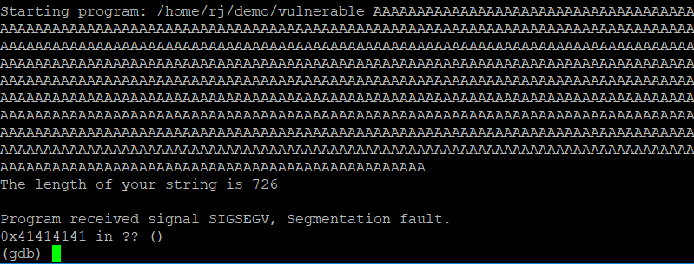
Stack Smashing
The bof function tried to return to 0x41414141 (an invalid address) and caused a segfault
0x41 is ‘A’ in ASCII

Slide 23
Planning the Exploit
We can control the address that the bof function returns to if we pass it specially crafted input
(Instead of screaming at it)
The construction of the input will be in this form:
NOP Sled
Shellcode
Return Addresses

Slide 24
Planning the Exploit
We can control the address that the bof function returns to if we pass it specially crafted input
(Instead of screaming at it)
The construction of the input will be in this form:
(Sizes are also semi to scale)
512 bytes for the buffer is pretty huge
Return Addresses
Shellcode
NOP Sled

Slide 25
Shellcode
Instructions with the purpose of opening a shell
In this example, a root shell
It can’t contain any NULL characters
1) It’s being passed in as command line input
2) strcpy will go until it sees a NULL character
It’s often limited to a very small size

Slide 26
Return Addresses
We need to figure out where the return address of bof is in order to overwrite it with our own
It’s a bit higher on the stack than the local variables
We could do the math…
(Easier to pretend math doesn’t exist)
Or we can just include a bunch of copies of our return address in our exploit and hope one overwrites it
Always word aligned (so no “partial” overwrite)

Slide 27
Return Addresses
We also need to decide what the value of our return address should be
We don’t know what the address of the shellcode is, but we can estimate it
ASLR == Address Space Layout Randomization
Turning it off makes it easier to find/predict where things will be
Notes:
* Without ASLR

Slide 28
NOP Sled
Fill a large area of memory with NOP instructions before the shellcode
If our estimate points to anywhere in the NOP sled, we’ll end up executing the shellcode

Slide 29
Putting it all together
The return address of bof() is overwritten and the function returns to somewhere in the NOP sled
The NOP sled leads execution to the start of the shellcode
The shellcode executes and we get a root shell
NOP Sled
Shellcode
Return Addresses

Slide 30
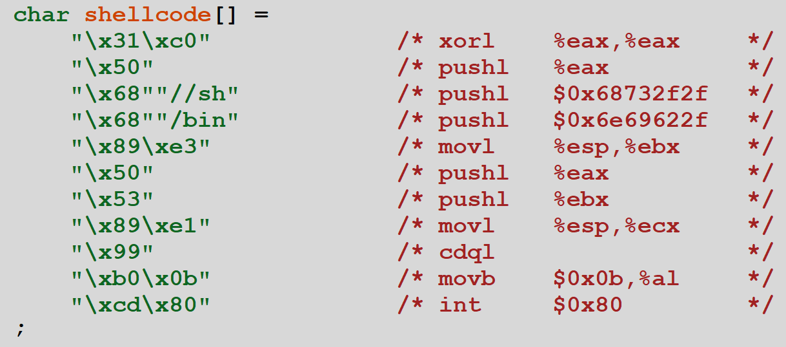
Writing the Exploit (Shellcode)
Will explain how this works next time (opens a root shell)

Slide 31
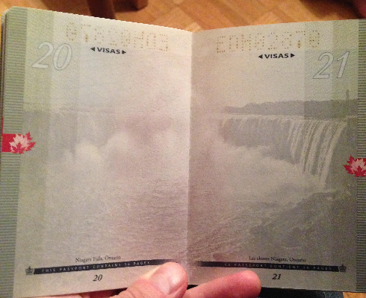
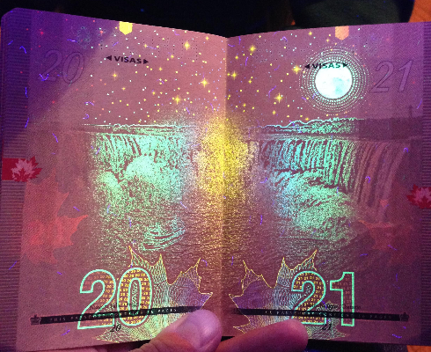
Daily Security Tidbit
Canadian passports have a neat security feature
Can see more examples at
https://imgur.com/gallery/3u8xP

